Slide 1
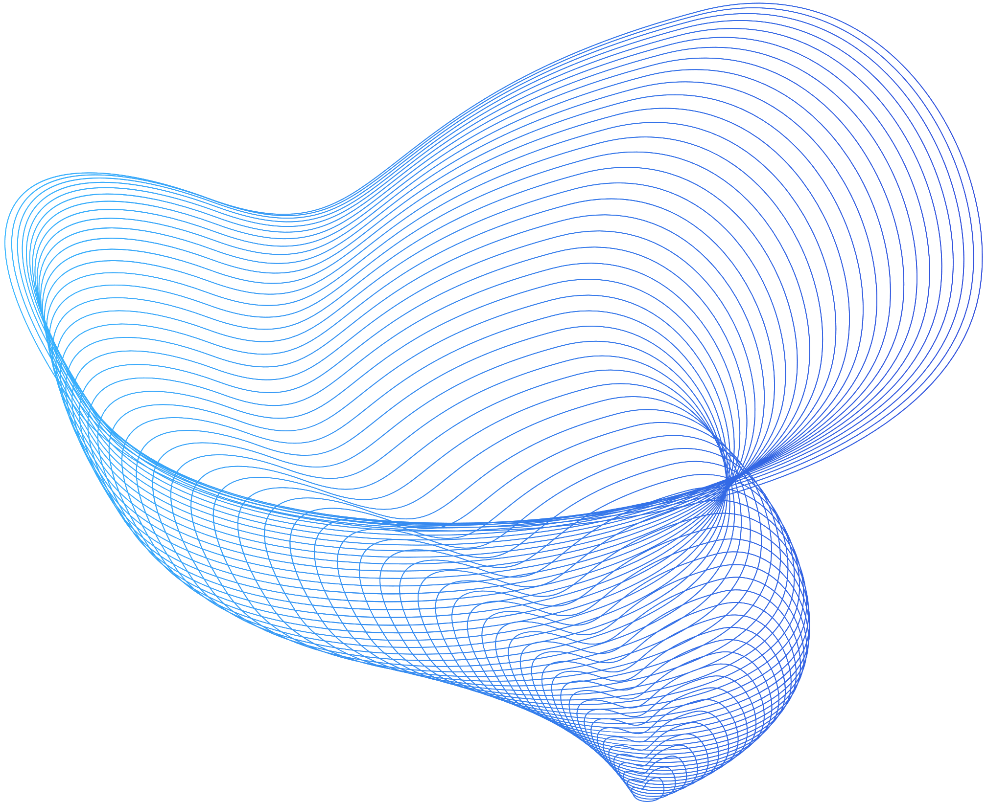

Cheems Coders
Graphical Authentication System for Online Banking
Presented by Cheems Coders

Slide 2

TABLE OF CONTENTS
Introduction
Problem
Describe the solution.
Scalability and Versatility
Future Scope
Conclusion.

Slide 3
INTRODUCTION
Graphic authentication system enhances online banking security.
Uses images and patterns for user verification.
Provides simple and secure access to online banking accounts.
It can be used on various devices with an internet connection.
Constantly changing images and patterns to prevent fraud.
Enhances the security of users' financial information and transactions.

Slide 4
PROBLEM STATEMENT
Online banking is convenient and essential but also presents risk for cybercrime.
Text-based passwords are inadequate for securing online banking transactions.
Passwords can be easily forgotten or hacked, putting sensitive information at risk.
81% of data breaches involve weak or stolen passwords, highlighting the need for a more secure authentication method.
Traditional text-based password system is no longer enough to protect against cybercrime.
Graphical authentication system offers a solution that provides both security and user experience.

Slide 5
SOLUTION
Development of a graphical authentication system for online banking.
Users set a pattern on a grid during signup, which is hashes(using SHA-256) and stored in the database.
The pattern serves as the second factor for authentication during login.
The system compares entered pattern with the one stored in the database.
The use of patterns on a grid is more secure, memorable, and user-friendly than traditional passwords.
Provides better user experience while ensuring the security of online banking transactions.

Slide 6
Encrypts into hash
code
Sign Up
Email and Password
Random Grid
Stores into the database
Checks with the st
ored encrypted code
Hashed the pattern
then checks.
Login
Grid Authentication
Checking
User Authenticated
Email and Password

Slide 7
SCALABILITY AND VERSATILITY
Integration with existing online banking systems.
Seamless transition for users.
Potential for use across a variety of platforms, including web and mobile.
Accessible to a large audience.

Slide 8
FUTURE SCOPE
Convert the project into an API or SDK format.
Easier for developers to integrate into their own applications.
Bringing the benefits of a graphical authentication system to more users.
Dynamic Grids.
ML Algorithm to detect unfamiliar activities.

Slide 9
CONCLUSION
Graphic authentication systems are becoming popular for enhancing security in online banking.
Use images and patterns for user verification instead of solely relying on passwords or security questions.
Provides a simple and intuitive way for users to access their online banking accounts and makes it harder for fraudsters to gain access.
Users select a specific image or pattern to log in, repeated each time the account is accessed.
Easy to use, no additional software or hardware needed and can be used on any device with an internet connection.

Slide 10
Thank You
Team Members ;
Anurag Mishra
Ayushh Khare
Bhavishya Upadhya
Abhishek Tripathi

